Slide 1
My Vision for Computing Education
Research and Practice

Slide 2

“No scene from prehistory is quite so vivid as that of the mortal struggles of great beasts in the tar pits. In the mind’s eye, one sees dinosaurs, mammoths, and saber-toothed tigers struggling against the grip of the tar. The fiercer the struggle, the more entangling the tar, and no beast is so strong or so skillful but that he ultimately becomes ensnared.
Development of model curricula that mesh computer science and engineering has, over the past decade, been such a tar pit, and many great and powerful beasts have thrashed violently in it.” (Mulder 1975)
(Brooks, 1975)
Notes:
To be able to look forward (which is in some ways what I have been asked to do), I always think it’s a good idea to look back, too.
The Mythical Man Month is by Fred Brooks.

Slide 3
A Maturing Discipline
Novel Degree Programmes
Computing in Schools
Computing Education Research

Slide 4
A Maturing Discipline
Implications & Scenarios for the Future
Mission accomplished, so no more curriculum reports?
  “That’s the thought that comes to my mind from reflecting back and thinking about where we are today. How much of the need was because it was a young, new field with many of the educators being converted from their training before computing training was widely available to being a mature field? Is the one that just came out the last one?”
Notes:
Reviewed lots of data (including archival materials).
Identified those in my work, but might argue that none of those are actually what’s going on.
For them, dispositons + knowledge + skills = competencies.

Slide 5
A Maturing Discipline
Implications & Scenarios for the Future
Mission accomplished, so no more curriculum reports?
    The newest report (CC2020) moved to using competencies.
A vastly restricted curriculum, with an essential core and an empirical examination of authentic practice.
Continued growth of the discipline, along with an inherent increase in subject matter knowledge.
    This view implies that a single undergraduate degree can and should still encompass the whole field.
Notes:
Reviewed lots of data (including archival materials).
Identified those in my work, but might argue that none of those are actually what’s going on.
For them, dispositons + knowledge + skills = competencies.

Slide 6

Novel Degree Programmes
Compressed Degrees
New institutions of higher education, especially in engineering education, are offering advanced degrees over shorter periods of time.
  “[…] it will be a unique curriculum model that will enable learners to gain an MEng in three (46-weeks) years and will place learning-by-doing over lectures, and learning-by-results over exams.”

Slide 7

Novel Degree Programmes
Compressed Degrees
New institutions of higher education, especially in engineering education, are offering advanced degrees over shorter periods of time.
  “Exceptional students […] could complete the bachelor's programme in two years, or the master's programme in three.”

Slide 8
Novel Degree Programmes
Work-Based Learning
Graduate apprenticeships were established in response to the persistent skills gap, with employers facing difficulties in recruiting adequately skilled employees.
  How are these programmes working for students, companies, and universities alike?
  Nationwide, what are the differences – at universities and in companies – in how these programmes have been implemented? How are these differences reflected in students’ experiences?
  What stories are students telling about their experiences?
Notes:
They combine part-time work with study at university, either in blocks of several weeks or day release to attend classes. Apprenticeships are paid positions, cover tuition fees, and are intended to attract students who would otherwise not have considered a degree.
Understand that your structure, with substantial time at university and in industry, is different from most.

Slide 9
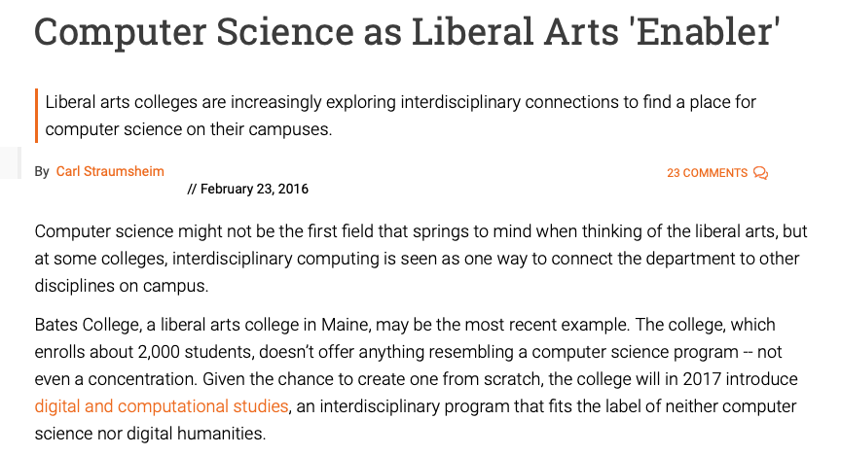
Novel Degree Programmes
Augmenting Other Disciplines
Establishing different forms of interdisciplinary degree programmes.
Incorporating computing into other degree programmes.
  One such example is the Year in Computing at the University of Kent (Dziallas, Fincher, Johnson, Utting, 2017).

Slide 10
Computing in Schools
“From Specialist to Mainstream Subject…”
Computing as a subject is moving from universities into schools.
  But the number of computing teachers in Scotland is declining (Robertson, 2019).
Connections between researchers and teachers are limited.
  But there is a growing body of work on computational thinking and literacy.

Slide 11
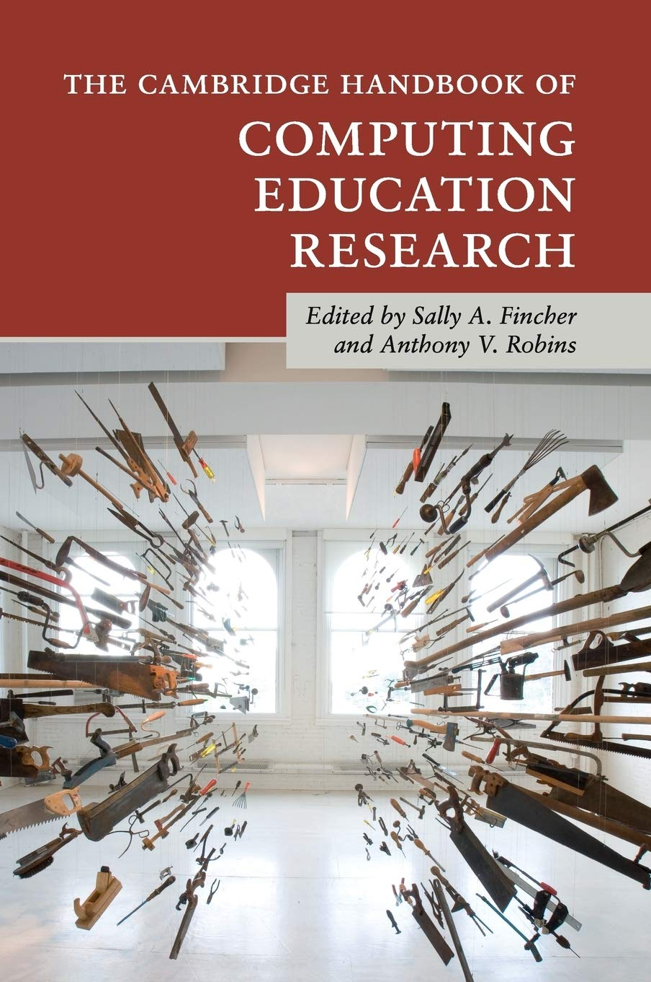
Computing in Schools
Computational Thinking
“We need large-scale, longitudinal comparison of teaching, learning, and assessment of computational thinking across schools, cultures, and age groups. We then need continuous professional development for teachers and resources to be developed based on the research.” (Curzon, Bell, Waite, Dorling, 2019)
Notes:
That quote is from the computational thinking chapter in the handbook.

Slide 12
Computing in Schools
Computational Thinking
“We need large-scale, longitudinal comparison of teaching, learning, and assessment of computational thinking across schools, cultures, and age groups. We then need continuous professional development for teachers and resources to be developed based on the research.” (Curzon, Bell, Waite, Dorling, 2019)
Notes:
That quote is from the computational thinking chapter in the handbook.

Slide 13

Computing in Schools
Longitudinal Comparisons
“Given the increasing impact of data and computing in our society, understanding the long-term impact of the subject on the curriculum and on pupils is essential.” (Royal Society, 2017)
My prior work has been looking at “the long-term impact of the subject on the curriculum and on” university graduates.
Notes:
Connect that to what I’m interested in. Can’t do all of that myself and wouldn’t want to claim to, but there are a few specific parts that overlap with my interests. And what about MNMI studies?
“After the Reboot: Computing Education in UK Schools”

Slide 14
Computing in Schools
Professional Development
Educators rarely deliberately search for sources to change their practice and most changes occur either because of personal interactions with other educators or without any outside influence at all (Fincher et al., 2012).
Pedagogical content knowledge is “a narrative way of knowing” and “narratives serve as a way of explaining that understanding to others.” (Gudmundsdottir, 1991)
Notes:
Indeed, Dancy and Henderson note that “although substantial time and money has gone into developing and disseminating research-based pedagogy and curriculum, the limited evidence available suggests that these reform efforts are having only a marginal impact” (Dancy & Henderson, 2008).
“Individual experiences, and the sense we make of them, shape who we are. For educators, experiential narratives affect both their day-to-day practice – the way they teach – and also the kind and quality of changes they make to their practice.”
always related to its context, I’m interested in practice
narrative nature (REES paper): dealbreaking behaviour (“That wouldn’t work for me.”)
“Teachers will not teach in a particular way if it is inconsistent with their [mental models] of children’s minds and learning.” (Strauss, 2001)
connect to curriculum stories
He is particularly concerned with pedagogical content knowledge, which, for him, is an essential part of the educator’s practice and “represents the blending of content and pedagogy into an understanding of how particular topics, problems, or issues are organized, represented, and adapted to the diverse interests and abilities of learners, and presented for instruction”

Slide 15
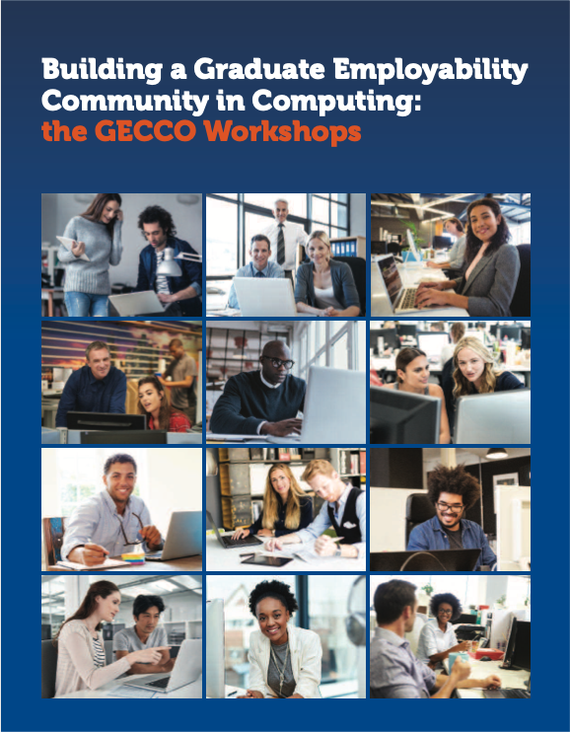
Computing in Schools
Sharing Practice
What stories do computing education teachers tell, both about their practice and in their classes?
Notes:
mention GECCO, I am interested in design-based approaches.
PLAN C?

Slide 16



Computing Education Research
Opportunities in the UK
There is growing interest in computing education research in the UK.
I am particularly interested in initiatives that help to build capacity in computing education research in the UK.
Notes:
I am also particularly interested in initiatives that help to build capacity in computing education research in the UK. In this, I would be able to draw on my experience developing interventions using design-based approaches as part of a series of nationwide workshops organised by the Council of Professors and Heads of Computing (CPHC) on graduate employability.
My own experience going to ICER.

Slide 17
What We Might Achieve
Graduate Apprenticeships
After four years, we would have…
Investigated graduate apprenticeship programmes at Glasgow and around the country.
Explored differences – at universities and in companies – in how these programmes are implemented and in how these differences are reflected in students’ experiences.
Reported on which aspects of these programmes have been successful for different stakeholders.

Slide 18
What We Might Achieve
Graduate Apprenticeships
After four years, we would have…
Investigated student pathways into and out of the programme, as students will have graduated in four year’s time.
Further examined Accountable Disciplinary Knowledge (ADK) across education and work boundaries.

Slide 19
What We Might Achieve
Longitudinal Studies
After four years, we would have…
Followed students – at university and in schools – over four years, having regularly elicited their narratives.
Explored students’ development as life-long learners.
  For example, this may expose turning points in students’ narratives, which would suggest areas where a small intervention (or change of intervention) could make considerable difference.
Notes:
There is presently a paucity of longitudinal narrative work on the effect of an education.

Slide 20

What We Might Achieve
Longitudinal Studies
After four years, we would have…
Collected a bank of life stories that reflects a comprehensive body of experiences (including, e.g., school or university leavers)
Notes:
The Identity Pathways Project is a longitudinal research study being conducted at Haverford College and Western Washington University. The aim of the project is to examine personality and identity development over the college years and beyond. The investigators are experts in personality, identity, relationships, and adolescent and emerging adult development with long histories of collaboration. We invite you to explore the webpage or contact us for more information about the research.

Slide 21
What We Might Achieve
More Ideas
After four years, we would have…
Explored the stories teachers tell about their teaching experiences and in the classroom.
Used design-based approaches to create opportunities for teachers to share practice.
Worked together to build capacity in computing education research in the UK.

Slide 22
Closing Thoughts
On Narratives
“Narratives are key components in the authentic study of teaching, for until we understand the context and appreciate the perspectives of those involved, any understanding of what it means to teach and learn will remain fragmented and disconnected from the real world of teaching.” (Olson, 1997)

Slide 23
My Vision for Computing Education
Research and Practice

