Slide 1
Turnitin
Word count tool is problematic– it includes everything in document. Would need to download original file from Moodle.
Every so often, come out of Turnitin and reload the window to avoid any issues with it logging out
Put the marks in the Excel sheet that Amanda will send, not in Turnitin

Slide 2
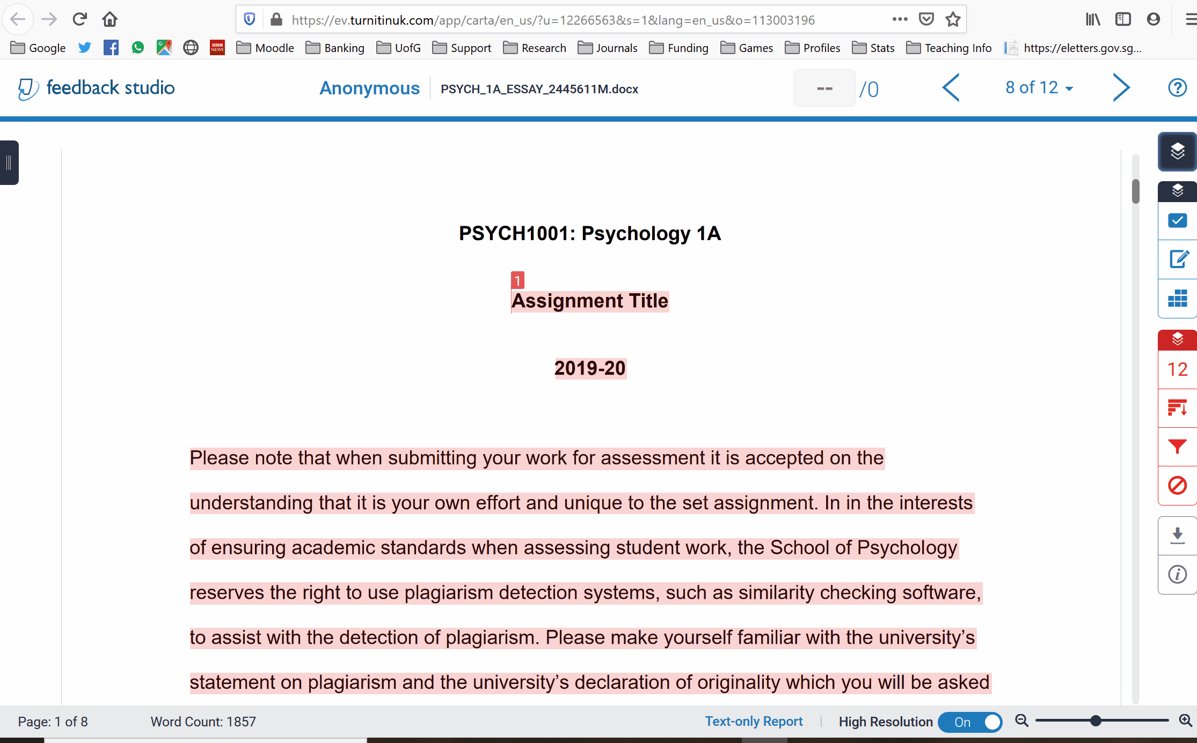
Turn off layers
Click on Layers
Uncheck similarity, check grading
The blue tools are the ones you need for grading
Red is for plagiarism stuff

Slide 3
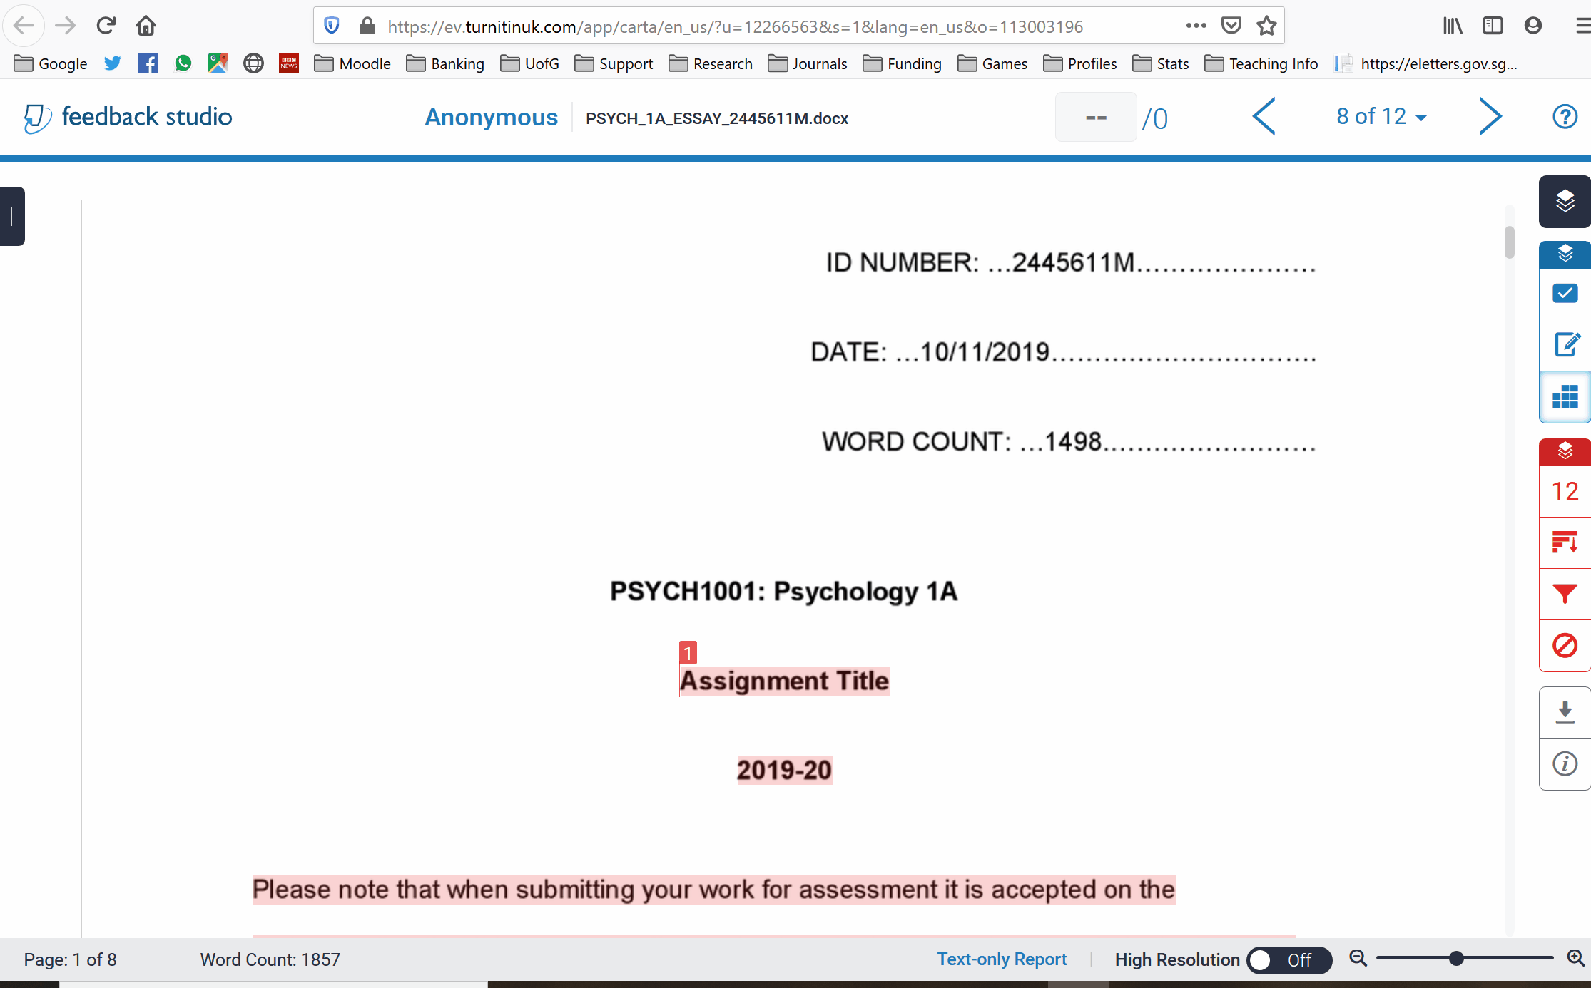
Strikethrough text

Slide 4
Add a comment
You can link a comment with a specific ILO you don’t have to do this but it’s a nice feature.

Slide 5
QuickMarks
QuickMarks are the comment banks of Turnitin
Developing good QuickMarks is a little time consuming to begin with, but massively speeds things up after a few report, particularly with formulaic reports where you are likely to repeat feedback for method/result section issues
It also means that you can hugely increase the amount of feedback you give, explain the issue in full once, and then drag-and-drop
And you can use them in all future assignments

Slide 6
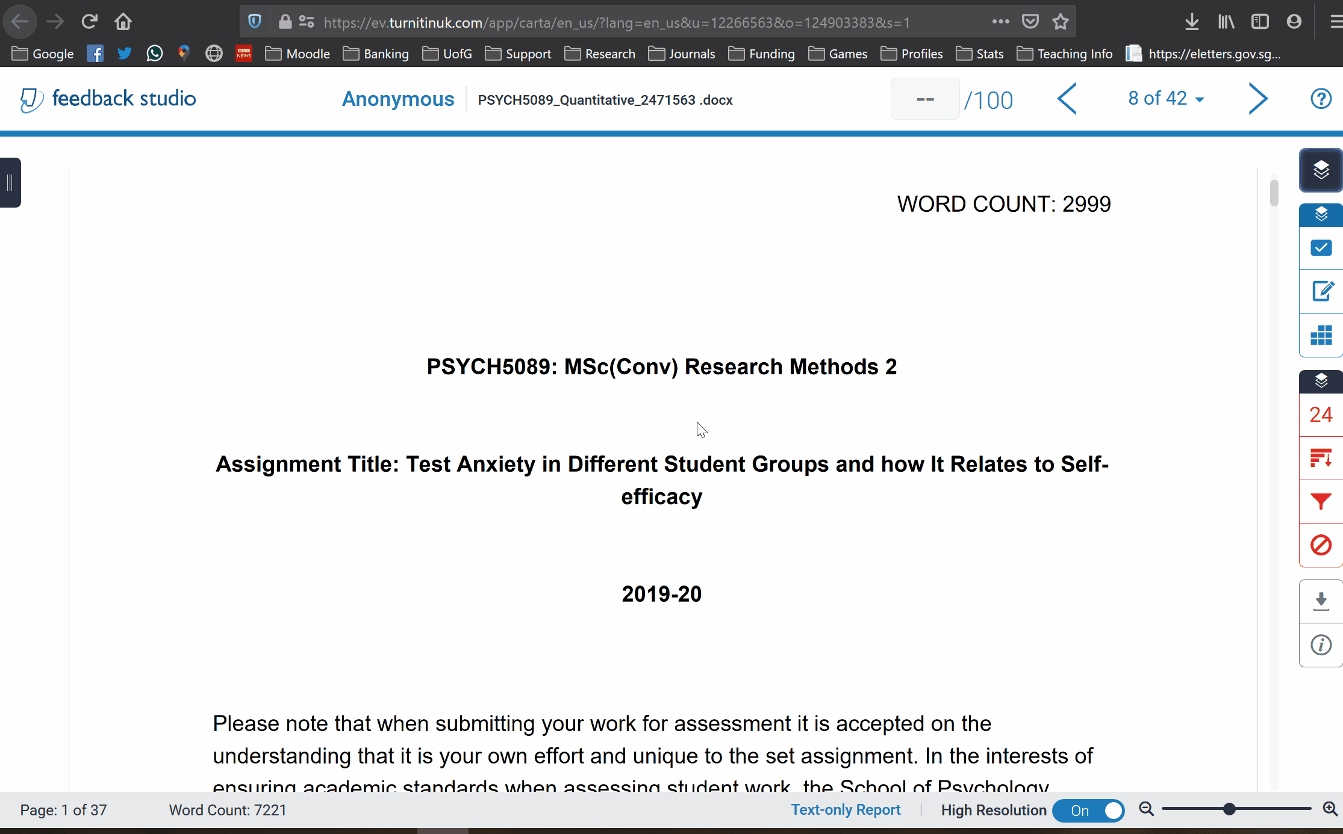
Convert a comment to a quickmark

Slide 7
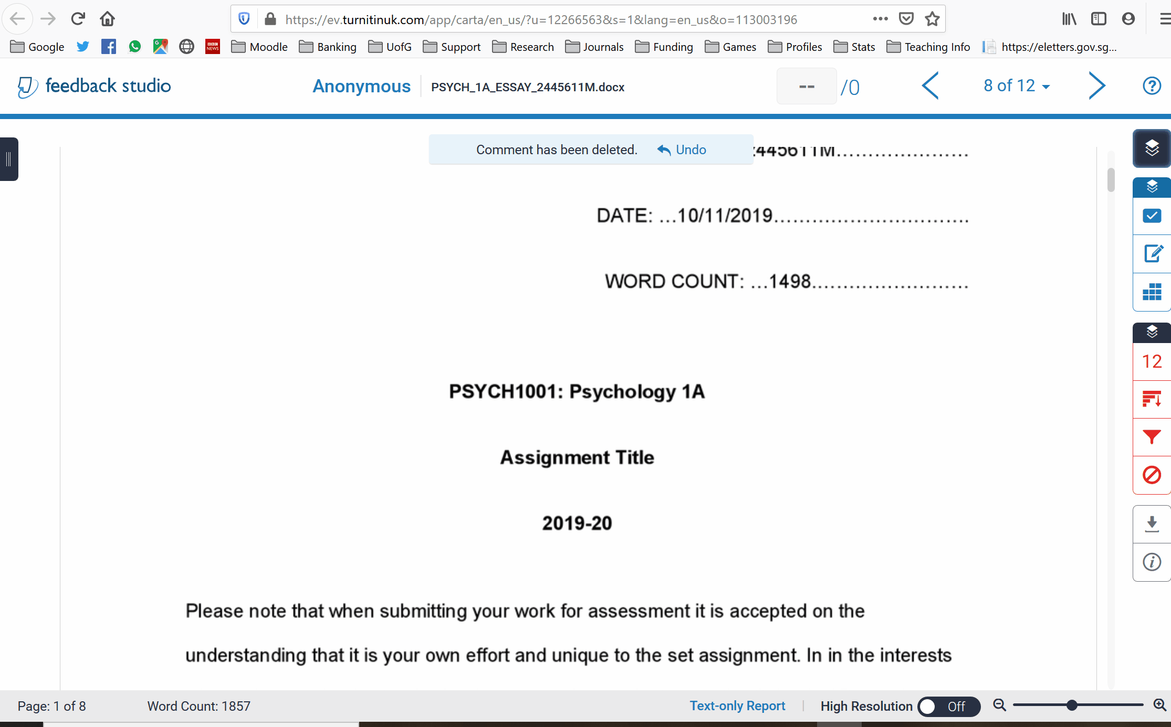
Reuse a QuickMark

Slide 8
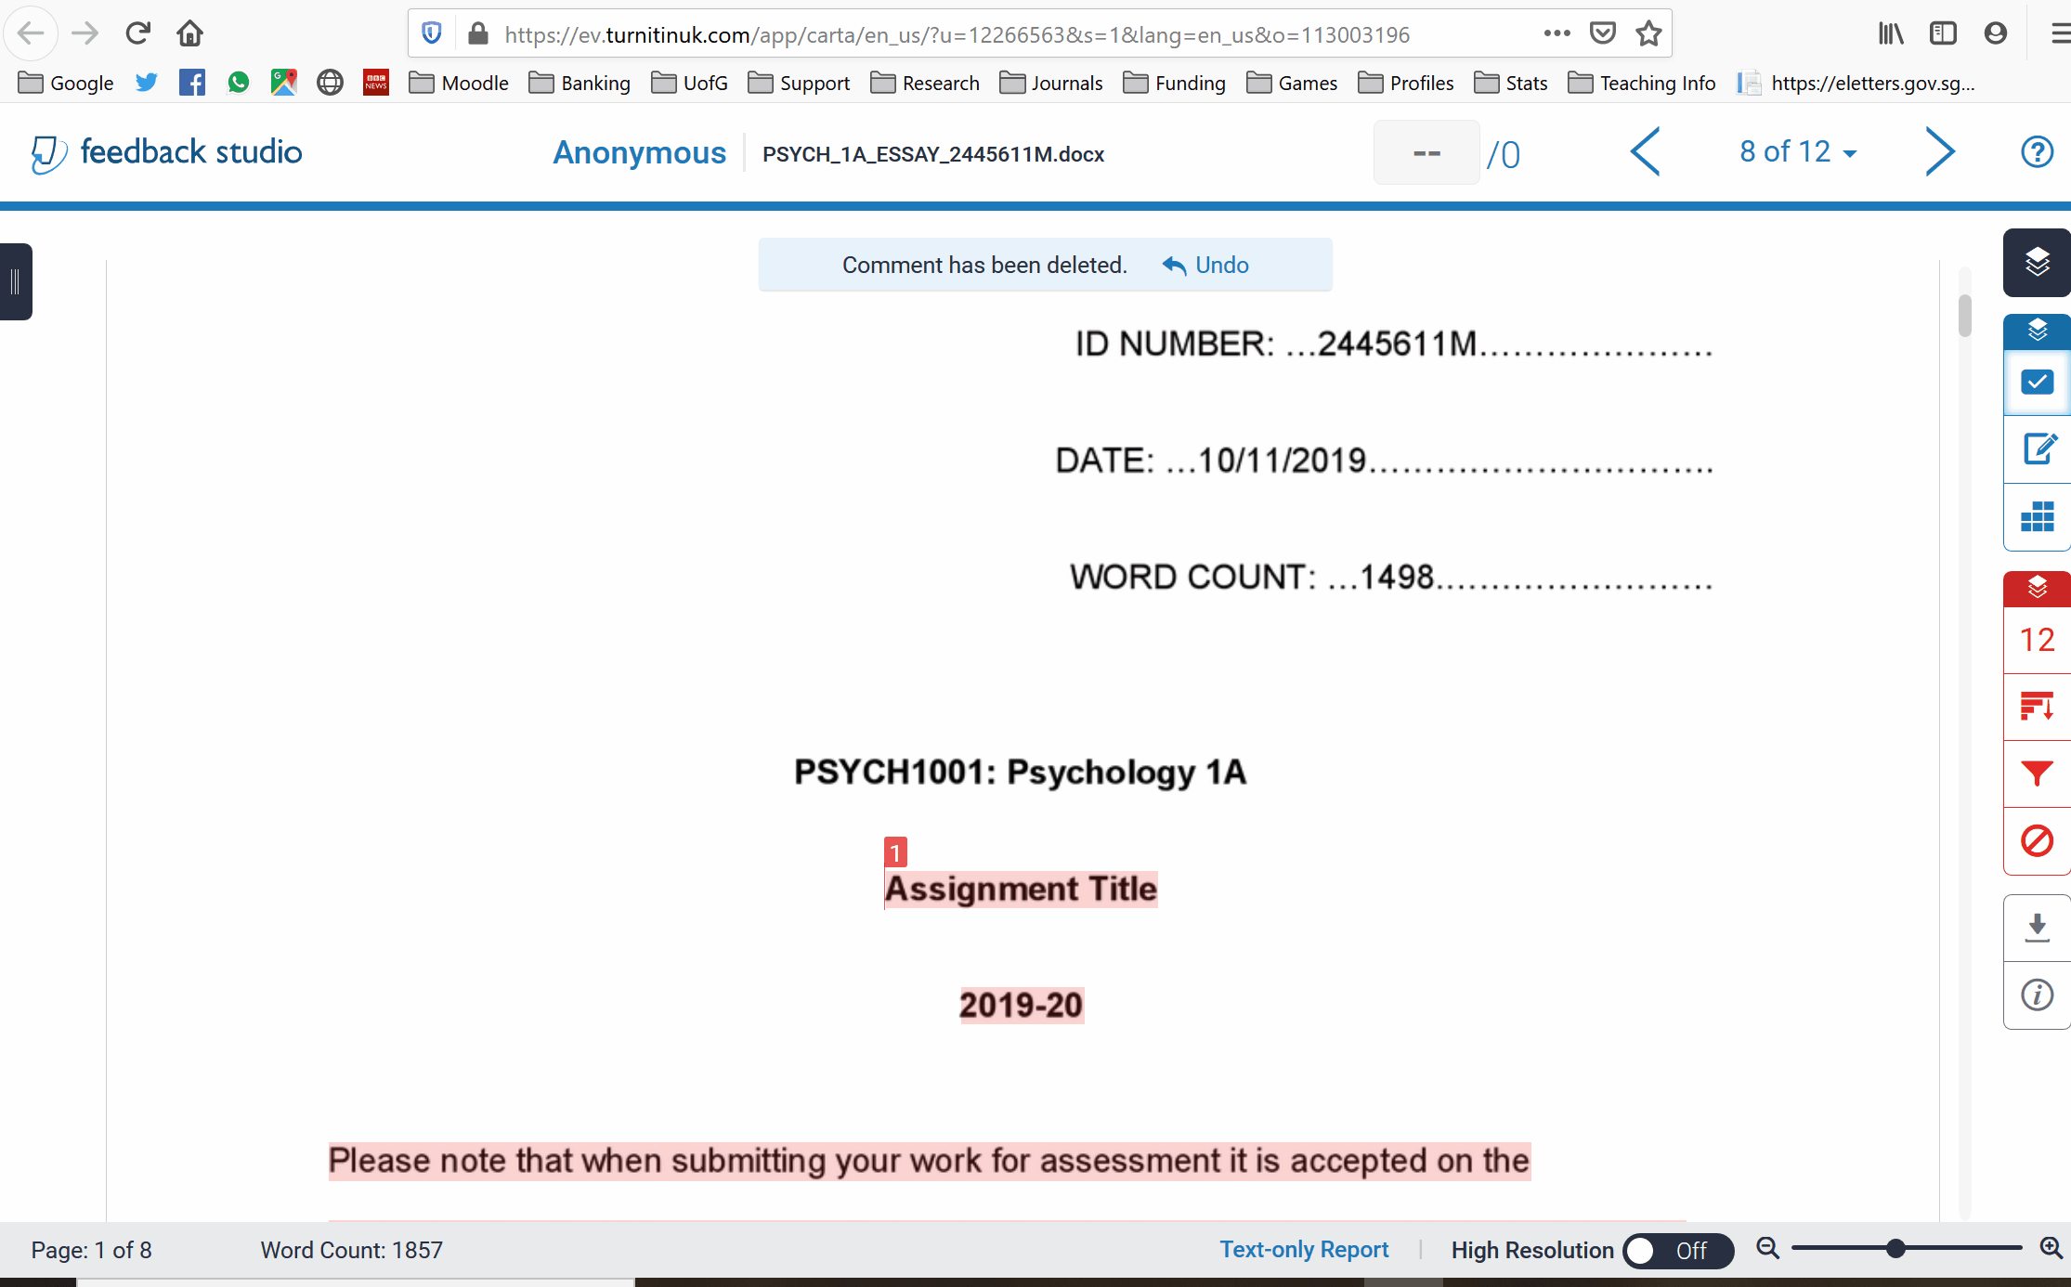
Create new QuickMark set
You don’t have to do this, I just like to have separate sets for each assignment I mark.

Slide 9
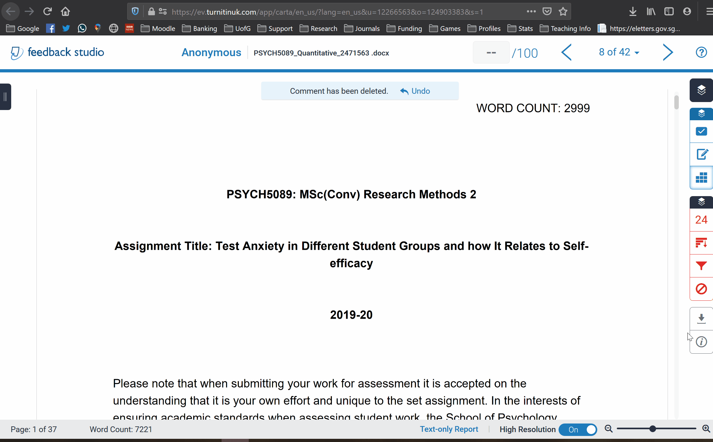
Edit QuickMarks

Slide 10
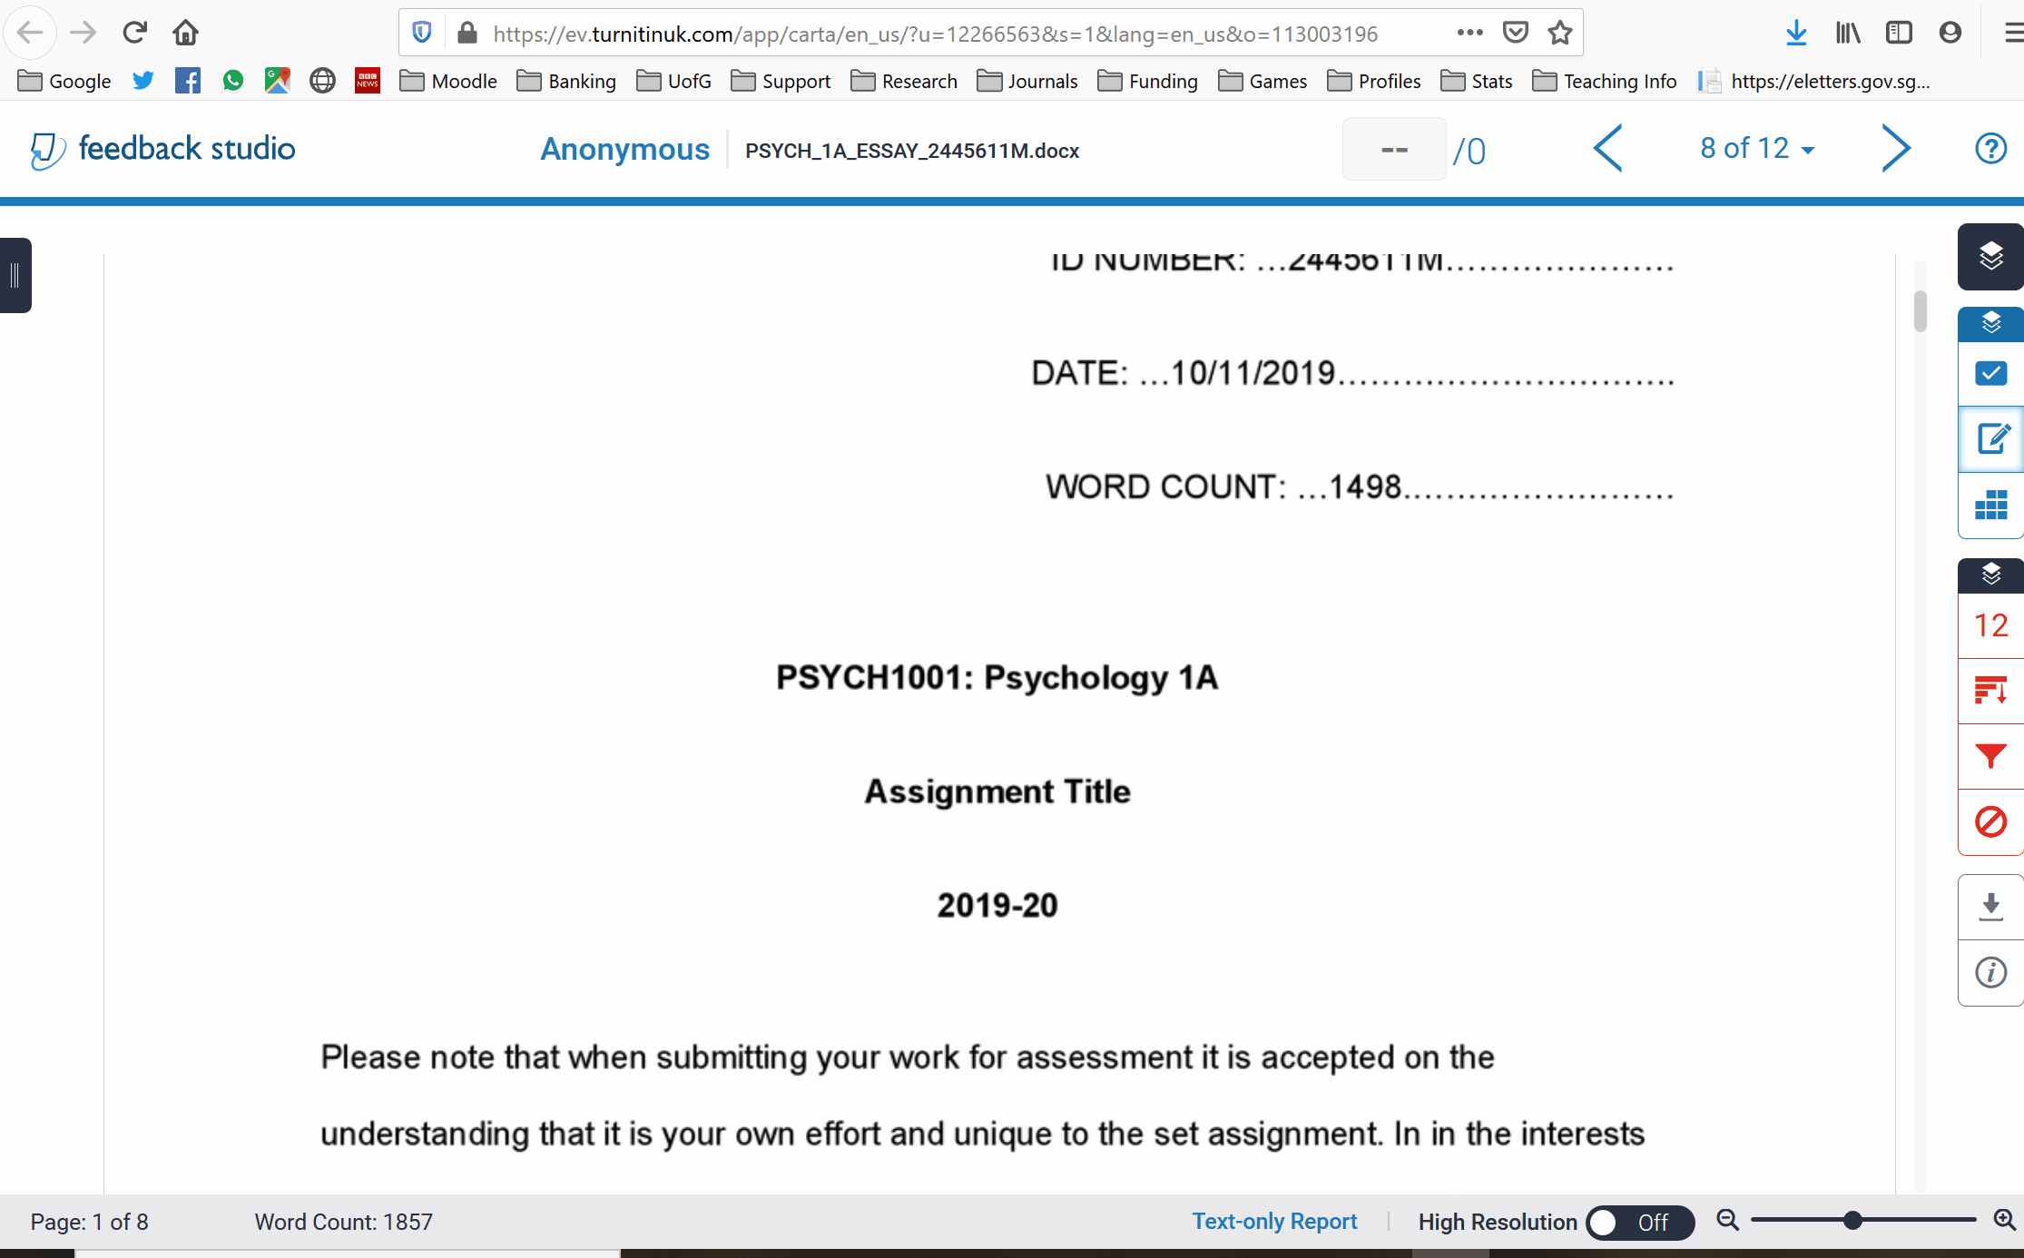
Leave an overall comment
Use this for feedforward/general overview comment

Slide 11
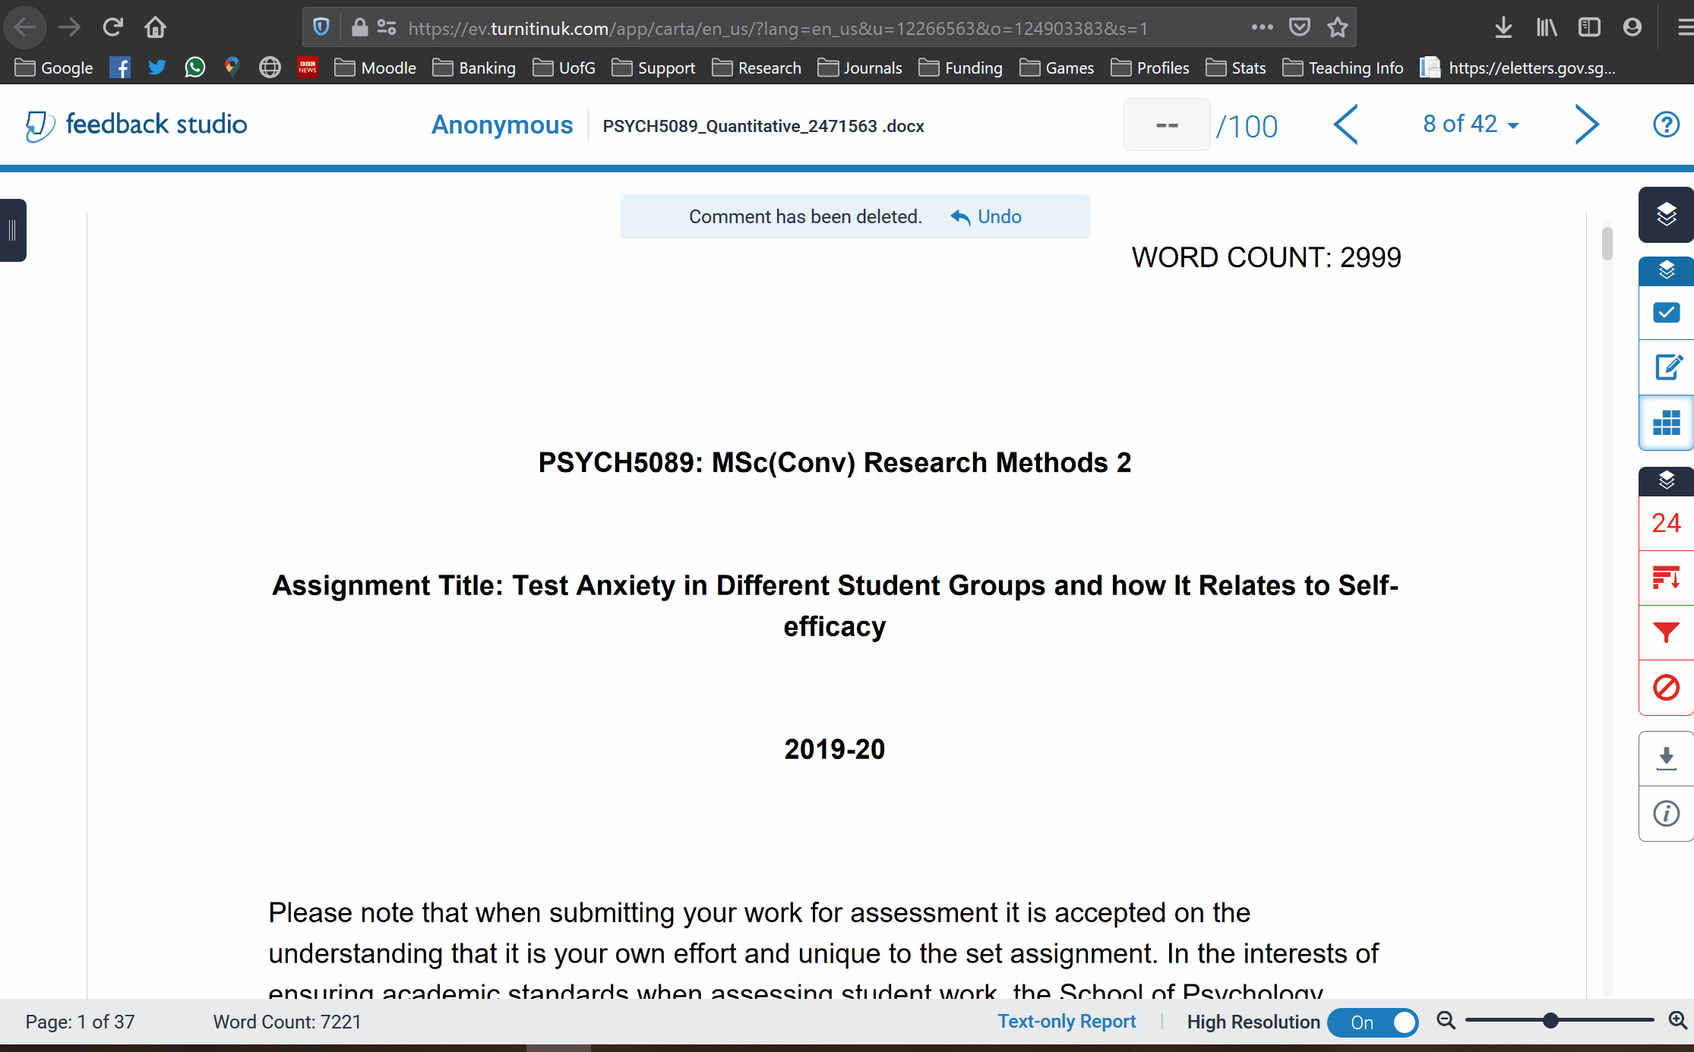
Rubric
This is the Turnitin equivalent of the feedback sheet boxes
Make sure lines up with grade

